Slide 1


Project name: Benchtop Environment Sensor Tester (BEST) Team members: Binkley, Weston; Livingston, Tyler; Pahwa, Samarth

Slide 2
Project description
Problem statement: “Sandia National Laboratories would like a consistent, reliable way to ensure that environmental sensors are working. These sensors measure temperature, air pressure, and acceleration.”

Slide 3
Project description
Solution proposal: “Create three electronically controlled environments to separately test accelerometers, thermocouples, and pressure sensors by comparing data against the actual conditions of the environment.”

Slide 4
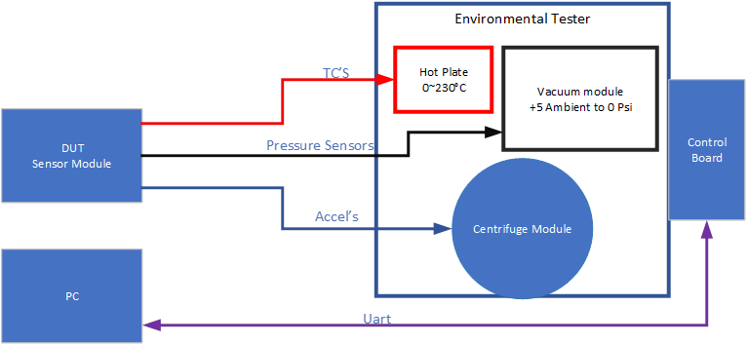
System Overview

Slide 5
Task partition
Tyler: “Power the three stimuli modules and all other electrical components in the system.”
Samarth: “Design general hardware including MCU, communication, and control circuits.”
Weston: “Write MCU and PC application firmware to read sensor data and send control signals to the environments, as well as read the DUT data.”

Slide 6
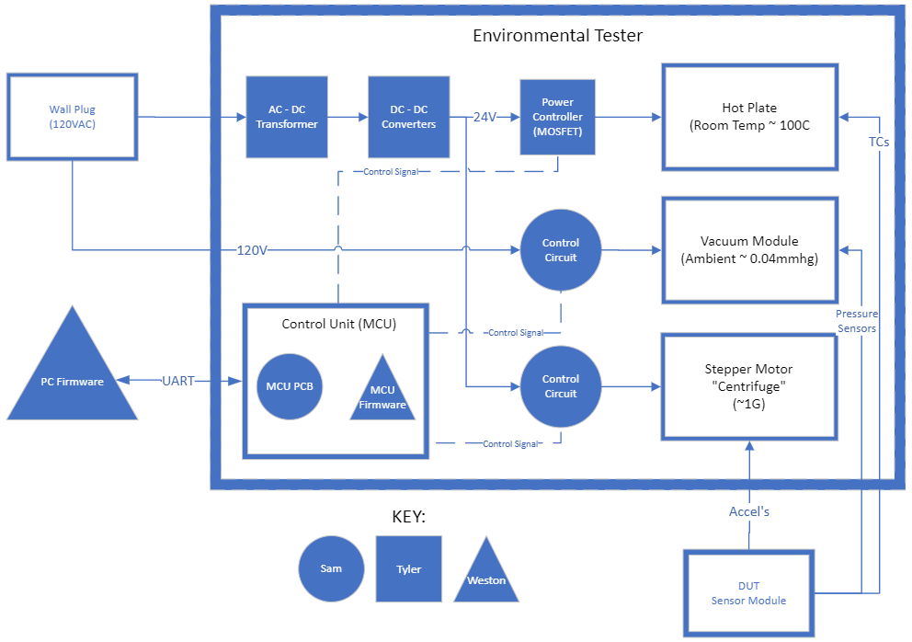
Subsystem Overview

Slide 7
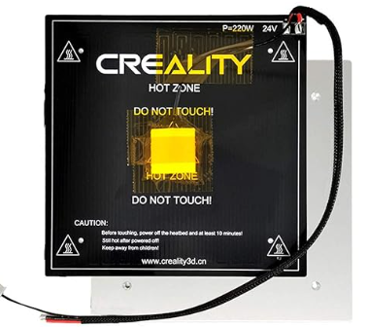
Hot Plate
24V DC 220W
235x235x3mm
Max Temp ~110C

Slide 8
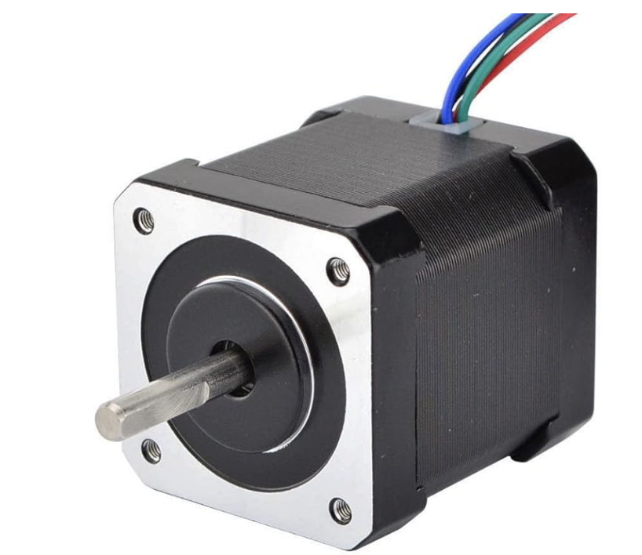
Stepper Motor
12 Volts
Up to 1000 rpm
48 mm

Slide 9
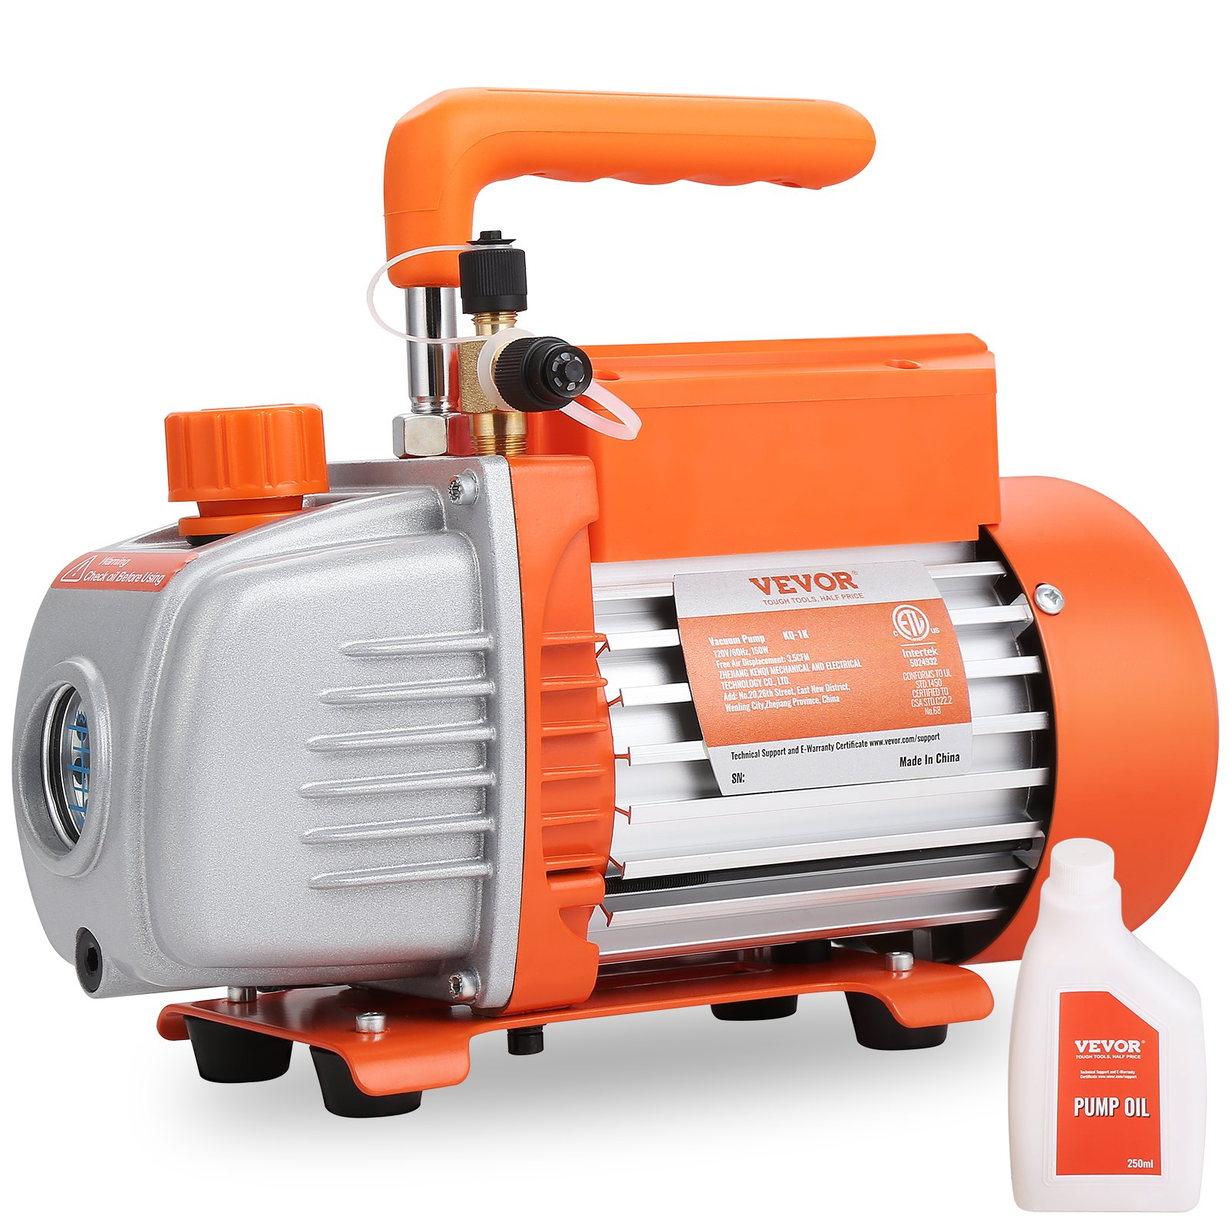
Vacuum Pump
120V AC
Maximum Vacuum 0.04 mmhg
11.9 lbs
11.4 x 4.7 x 8.66 in

Slide 10
Looking Forward
Focus on individual subsystems
Confirm Design
Simulate
Assemble
Test

Slide 11
Execution and Validation
 | February 28 | March 13 | March 27 | April 10 | April 24
Firmware | MCU “hello world” | Read sensor data | Send control signals | Control signal logic | Final Demos
Power | Complete Designs and Order Parts | PCB Designs and Preliminary Testing | Assembly | Testing and Validation | Final Demos
General Electronics | Order benchtop sensor parts | Basic part integration | MCU interface integration | Testing and validation | Final Demos

